Slide 1

Azure Option / Integration Upgrade options
INVP4904 - Credit Collection Analytic Engine (CCAE)
SQL Server Upgrade

Slide 2
CCAE Overview
The Credit Collection Analytic Engine (CCAE) was originally implemented to support the reporting needs of mainframe Applications CRS and CSS. Over time, it evolved to serve Collections-related analytical, transactional Web, reporting and many more.
Performance issue: User are facing performance issues for the last 6 months, when executing queries, accessing DB, accessing application.
• Long running queries: Users are facings issues in executing stored procedures and SQL statements. It is taking a long time to execute.
• Storage issues: Business users often getting the storage issue. Business team believe this is the main root cause for both Long running queries and performance issue.
Win Server 2008 R2 and Win Server 2012 R2 are out of main stream support and Win 2012 is on the extended support period. CCAE has 2 servers with Win Server 2008 and 3 servers with Win Server 2012 OS. To be complaint, these servers has to be upgraded.
SQL Server 2008 R2 is out of main stream support. In CCAE 3 database servers are using SQL 2008, which requires an upgrade.
H/W in Win 2008 servers are out of support.
Scope of the project is to upgrade H/W, OS, SQL Server and performance tuning.
Dec 2020
Pain Points
Scope of project INVP4904
Go-Live

Slide 3
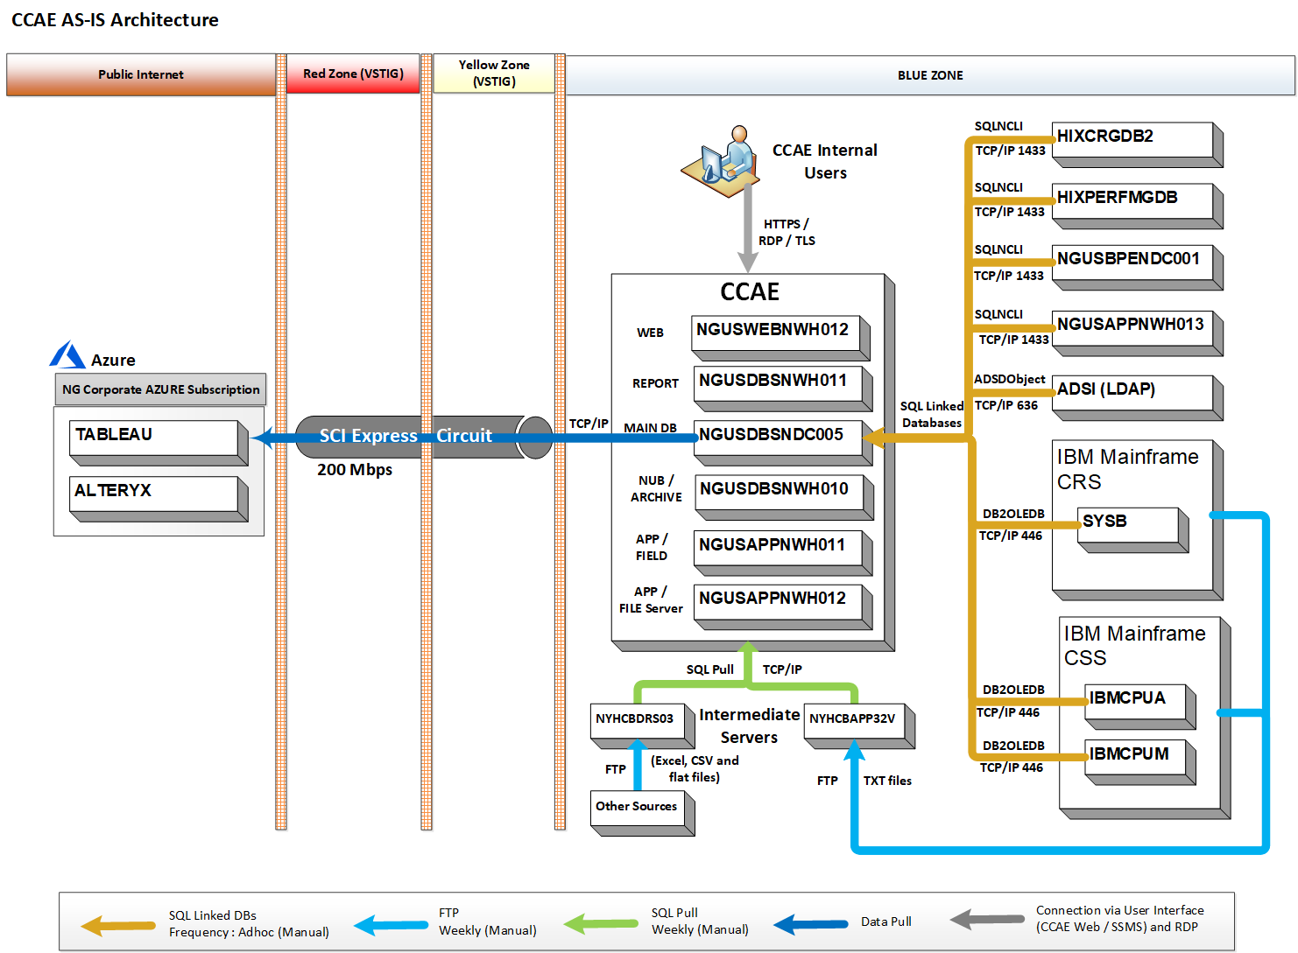
CCAE – Current State

Slide 4
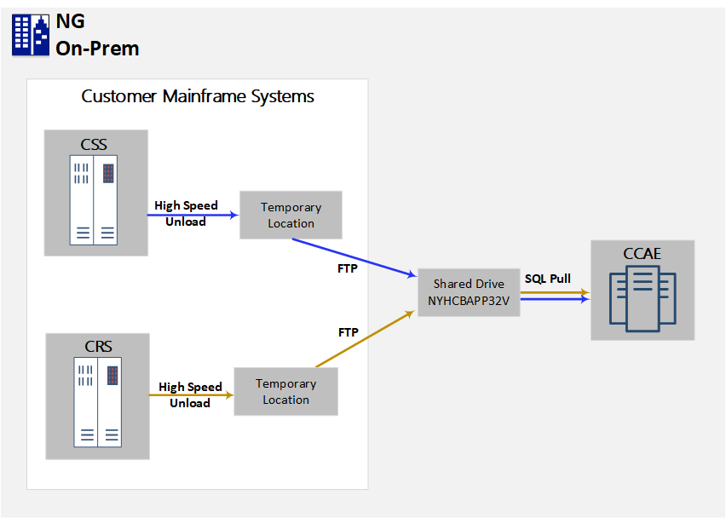
CCAE – Interface from CRIS/CSS Applications
CCAE getting ~600 GB of data weekly from CRIS and CSS systems.
CRS and CSS application unloads the data into the temporary location within their mainframe system thru a high-speed unload process (Automated – Weekly).
Based on the availability of the unload files, CCAE Business team initiate the FTP from Mainframe Unload location to a Shared Drive - NYHCBAPP32V (Manual – Weekly). FTP is done using mainframe jobs (no special tools used).
Once the files are available on the shared drive, CCAE business team initiate the import from CCAE Main database server (Manual - Weekly). The data get imported into the CCAE tables (CRS and CSS schemas).
CSS sends data for 61 Tables.
CRS sends data for 189 Tables.

Slide 5
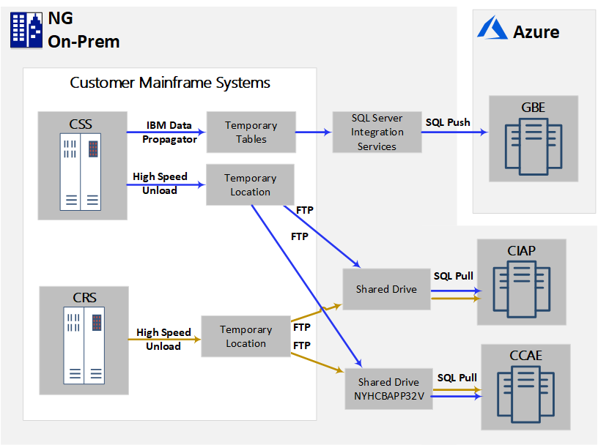
Other Interfaces from CRIS/CSS Applications
CRS and CSS applications sending data to multiple applications like CCAE, CIAP and GBE
CRS sends
197 tables to CIAP application
189 Tables to CCAE application.
CCAE has 180 tables in common with CIAP.
Similarly, CSS sends
61 tables to CCAE Application,
36 tables to GBE
82 tables to CIAP
CCAE has 23 tables in common with GBE
CCAE has 49 tables in common with CIAP

Slide 6
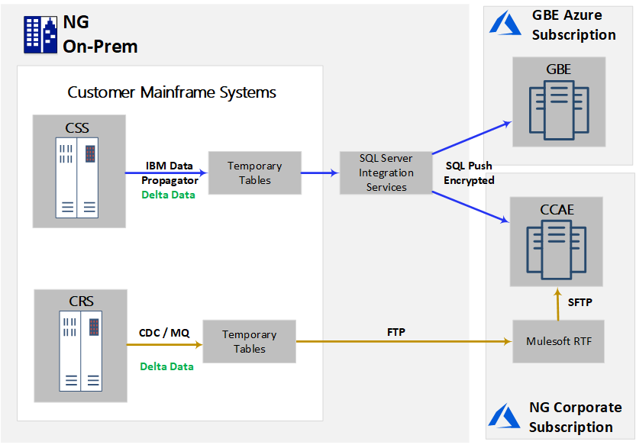
Azure Option with CRIS, CSS Integration
Azure option requires upgrade of the CRIS and CSS interfaces
It requires 1000+ interfaces to be built to transfer ~600 GB of Bulk data from CRIS and CSS. Files have to be splitted into <500 MB files.
Every byte of data transferred to Azure is chargeable, including network, storage, compute etc. (Recurring cost)
Instead implementing CDC at CRS and CSS side will enable us to get Delta data (one time cost)
CRIS
189 CRIS table data transferred to CCAE
CDC has to implemented for all those 189 tables
CSS
61 CSS tables data transferred to CCAE
CDC was already implemented on 36 tables to GBE
CCAE has 23 tables in common with GBE
CDC has to be implemented for the remaining 38 tables

